Slide 1
VSkul
Wiztute Private Limited

Slide 2
What does it do ?
Logistics
Teachers
Students
Complete end-to-end classroom logistics management platform

Slide 3
Major Components
Login (Teacher & Student)
Classrooms via Live Video Conferencing
Classroom Interaction
Assignments & Tests

Slide 4
Sign Up

Slide 5
Login

Slide 6
Teacher’s Dashboard
Your Classes
What’s happening in school ?
Assignments & Tests (Create & Grade)
Course Materials

Slide 7
Student’s Dashboard
Class 5 - B
Your Classes
What’s happening in school ?
Assignments & Tests (Create & Grade)
Course Materials

Slide 8
Teacher’s Dashboard – Your Classes
Create New Class
Existing Classes

Slide 9
Teacher’s Dashboard – Create New Class

Slide 10
Teachers’ Dashboard - Existing Classes

Slide 11
Students’ Dashboard - Your Classes

Slide 12
Teacher’s Calendar – Start a Virtual Class
Student’s join via meeting link in their calendar
Automatic Video Recording
Uploading of Video in Course Contents tab

Slide 13
Teacher’s Dashboard - Assignments (or Tests)

Slide 14
Student’s Dashboard – Assignment Submission

Slide 15
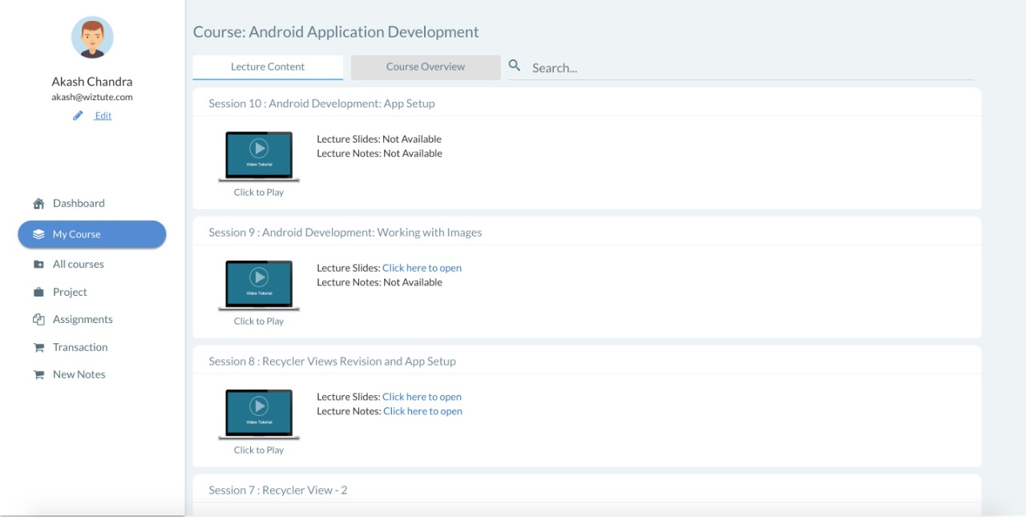
Course Content

Slide 16
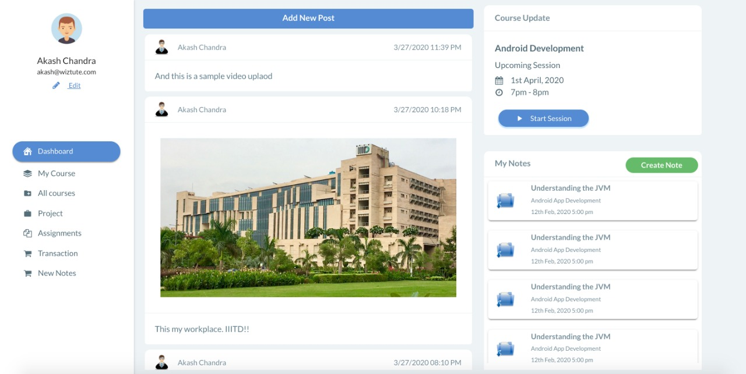
What’s happening in School ?

Slide 17
Thank You

